Slide 1


Slide 2
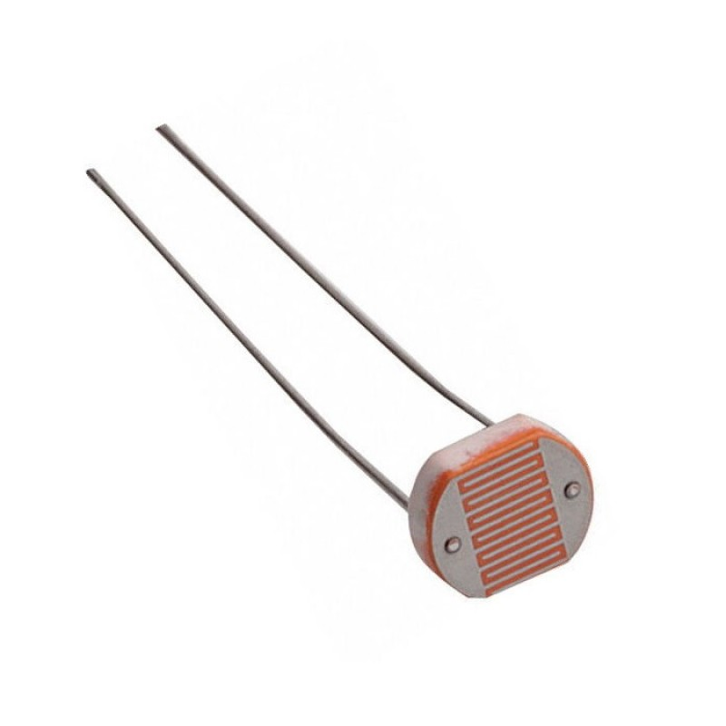
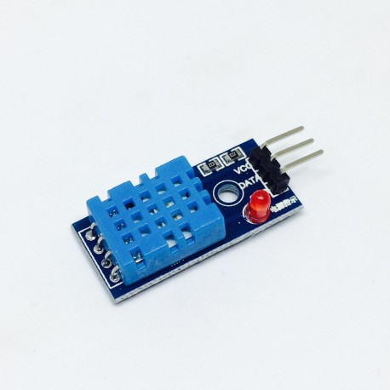

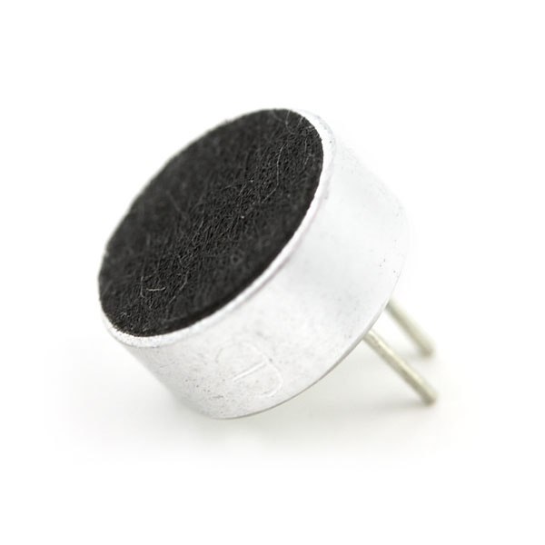
Components Points system
Points will be awarded for answering questions during the Arduino and Thunkable Workshops.
These points can be used to exchange for components which you might need in your project/idea in the hackathon.
Sensors available for points exchange:

Slide 3
Points criteria
Each workshop will have:
One easy question (1 point)
Two standard questions (2 points)
One hard question (3 points)
There will be 4 questions for each workshop, a total of 24 questions with 24 points.
Each component can be exchanged for one point.
Points will be given in stickers.

Slide 4
Introduction: What is Arduino?
Arduino is an open-source electronics software.
It is built for artists, designer, hobbyists and people who love designing and creating interactive objects!
It was founded in the Interaction Design Institute Ivrea (IDII) in Ivrea, Italy.
Similarly, in our case, we use it for programming.

Slide 5

What is Arduino?
The official logo of Arduino

Slide 6

Arduino microcontroller
In learning to use Arduino, we will each be using an Arduino UNO R3 module. The module is as shown below.
It is a programmable circuit board and it utilizes a much simpler version of the dreaded C++ programming language.

Slide 7
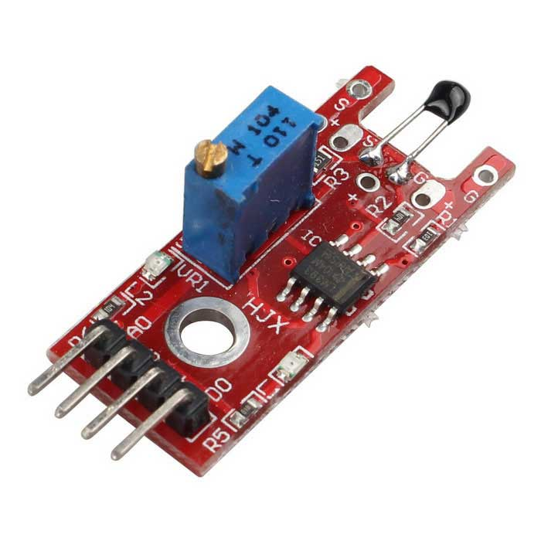
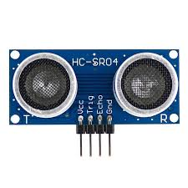
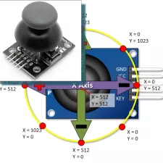
Arduino input sensors
Arduino Inputs Sensors range from temperature sensors, ultrasonic sensors, voltage sensors and a variety of switches. In fact, what makes it interesting is that you can even use PS2 analog sticks as controlling devices in Arduino!

Slide 8
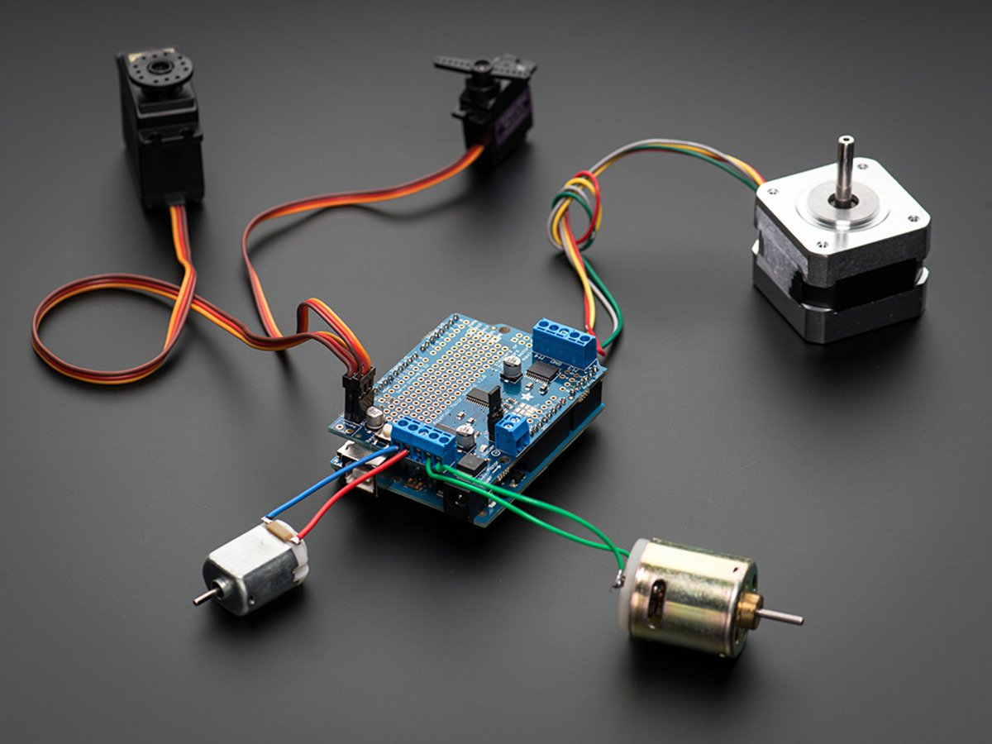
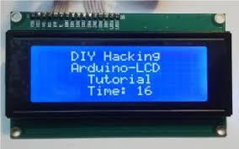
Arduino output devices
In Arduino, having input devices alone will not help us accomplish anything if the robots or devices built have no output devices. So, a few examples of output devices used in Arduino include a display screen, light or a motor.

Slide 9

Beginning…
Now let us start! In your groups, you are provided with an Arduino UNO R3 module to work on.
Further instructions will be provided.
Please handle them carefully and responsibly.

Slide 10
Downloading the Arduino software
On your laptops, go to www.arduino.cc.
On the menu bar at the top of the page, click the “Software” button.
On that page, download the latest version of Arduino which is Ver 1.8.5. according to the compatibility of the operating system of your device.
Install the program and run it when installation is complete.
Further instructions will be given.

Slide 11
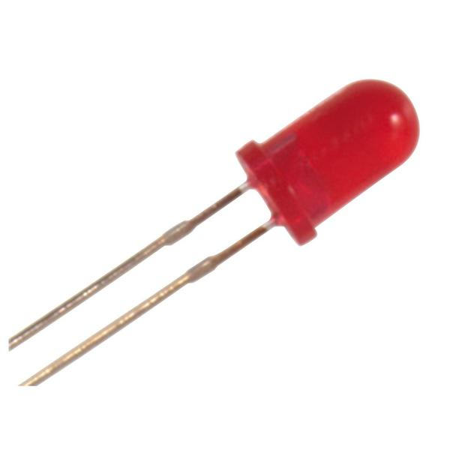
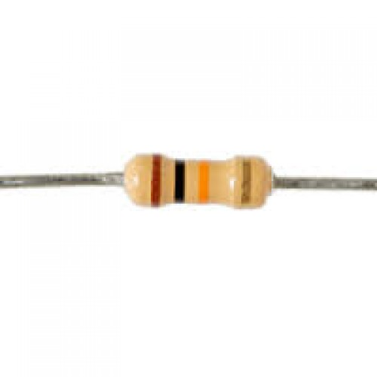
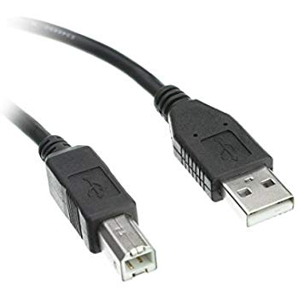
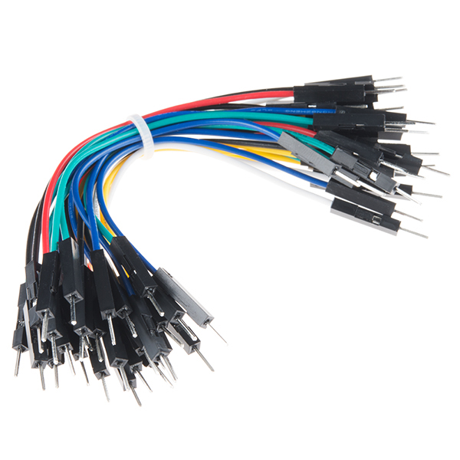
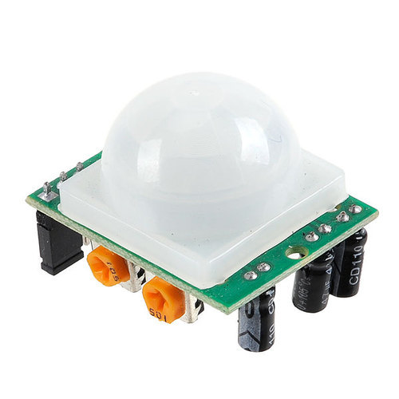
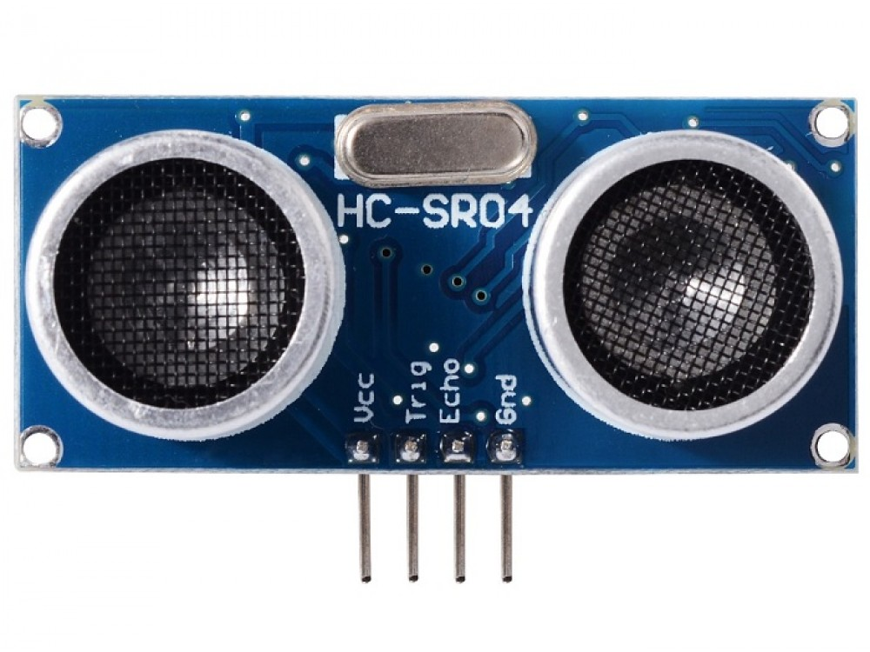
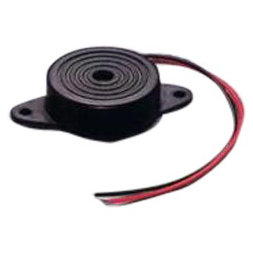
Materials! (Each GROUP)
Arduino Uno x1
Resistor x3
LED x 3
Piezoelectric Buzzer x1
Jumper wires x4
USB Cable type B
PIR Sensor x1 or Ultrasonic Sensor HC-SR04 x1

Slide 12
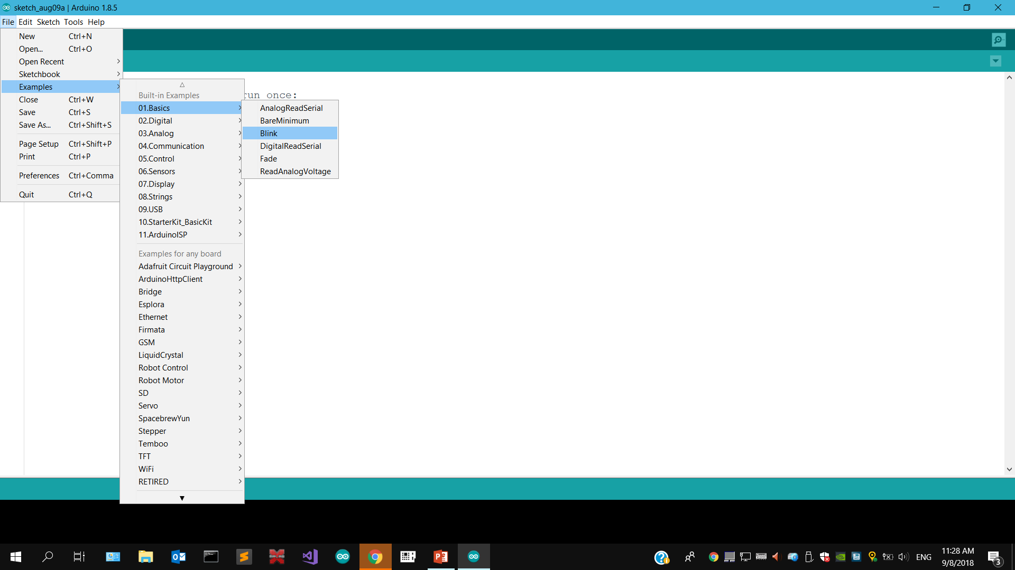
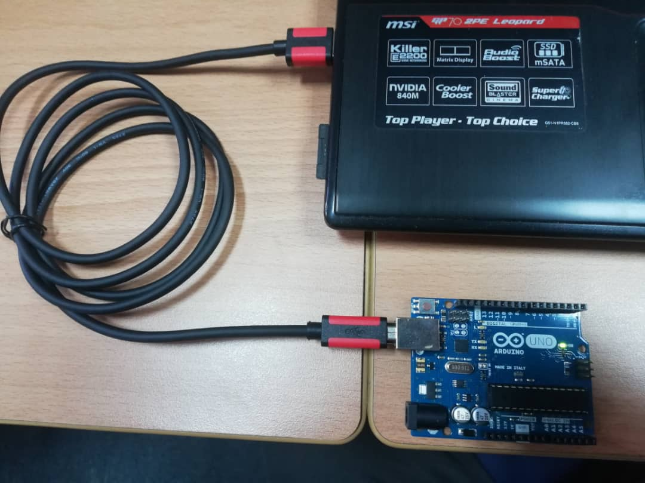
Let there be light!

Slide 13
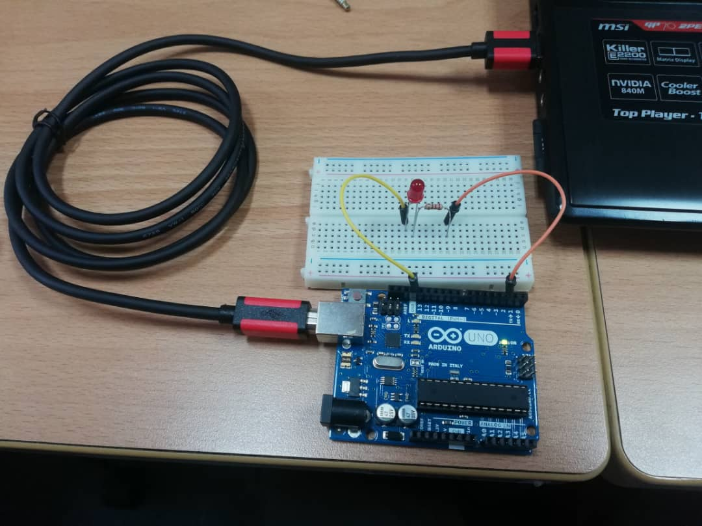
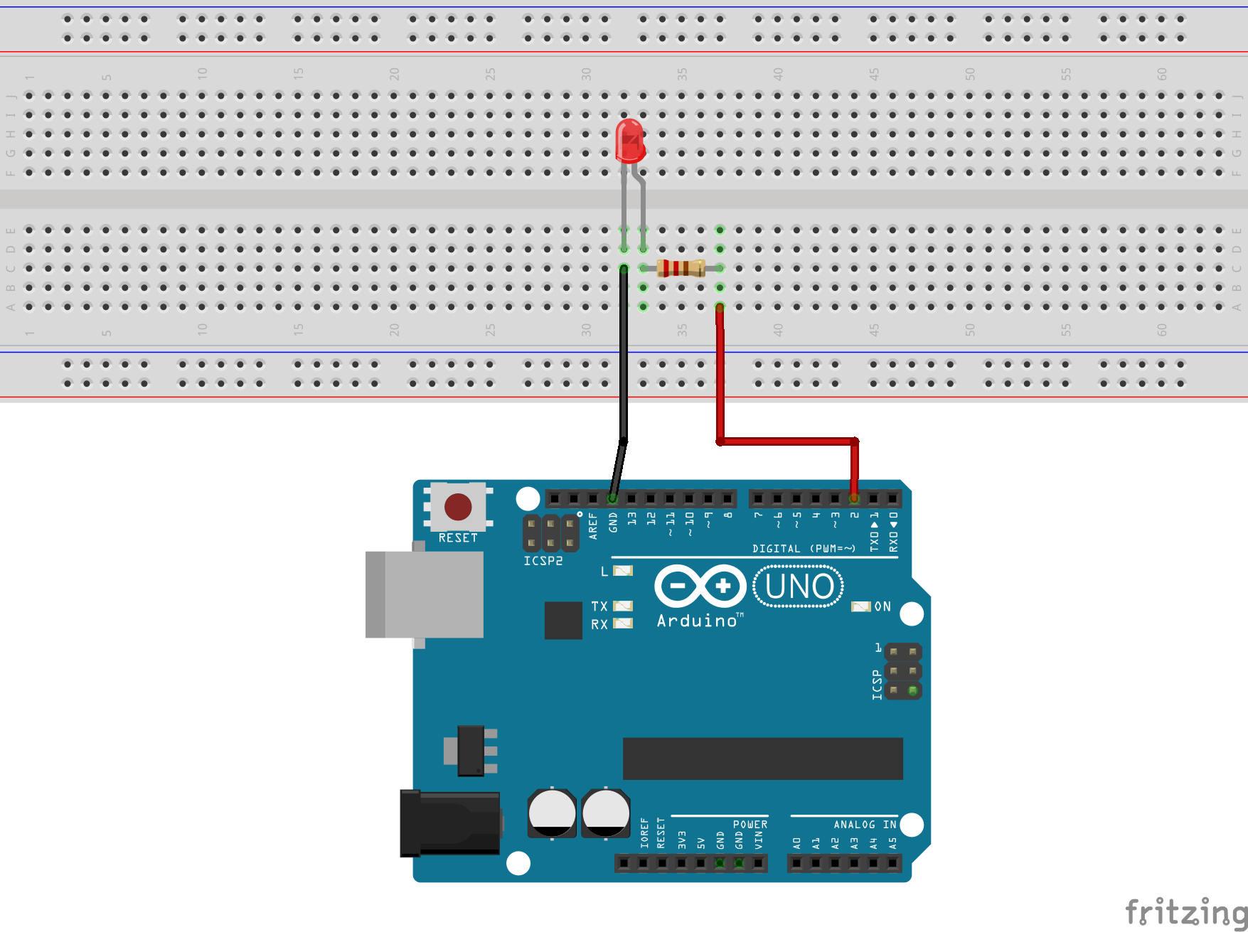
Add-on leds
Replace “LED_BUILTIN” to your pin number connected to your Arduino Uno. In this case, pin 2.

Slide 14
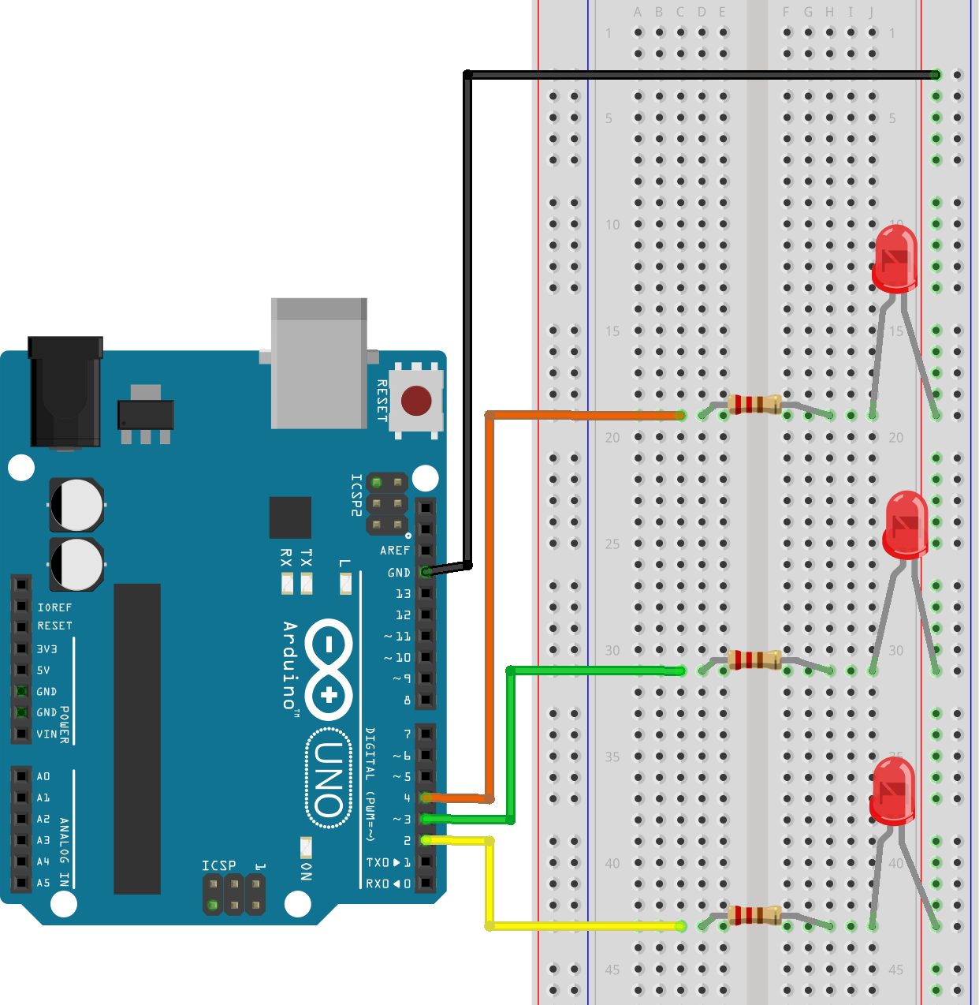
More leds!
This time, we are going to introduce more LEDs and learn how to control them one at a time.

Slide 15
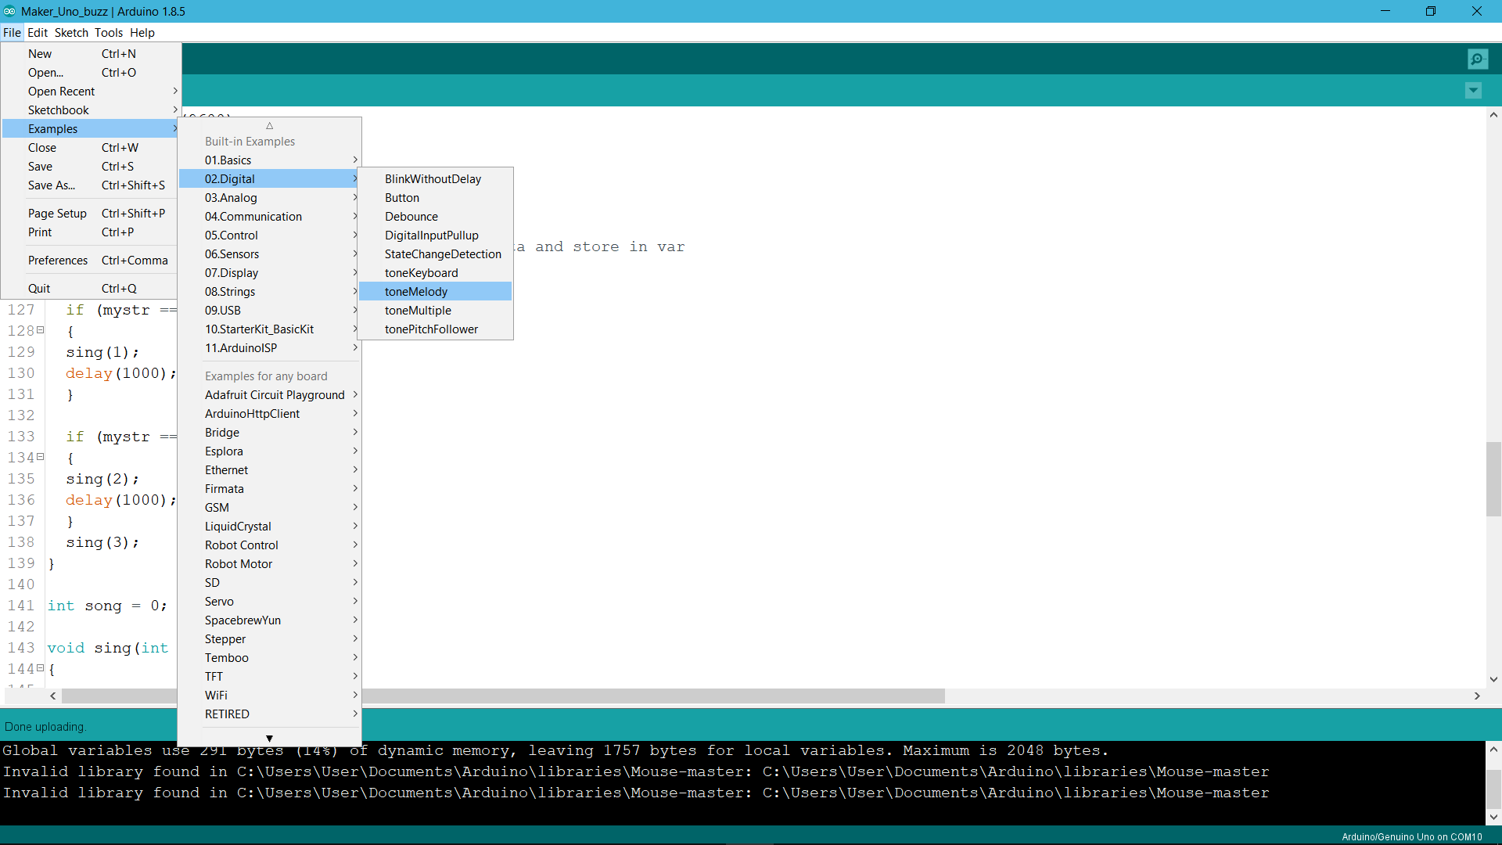
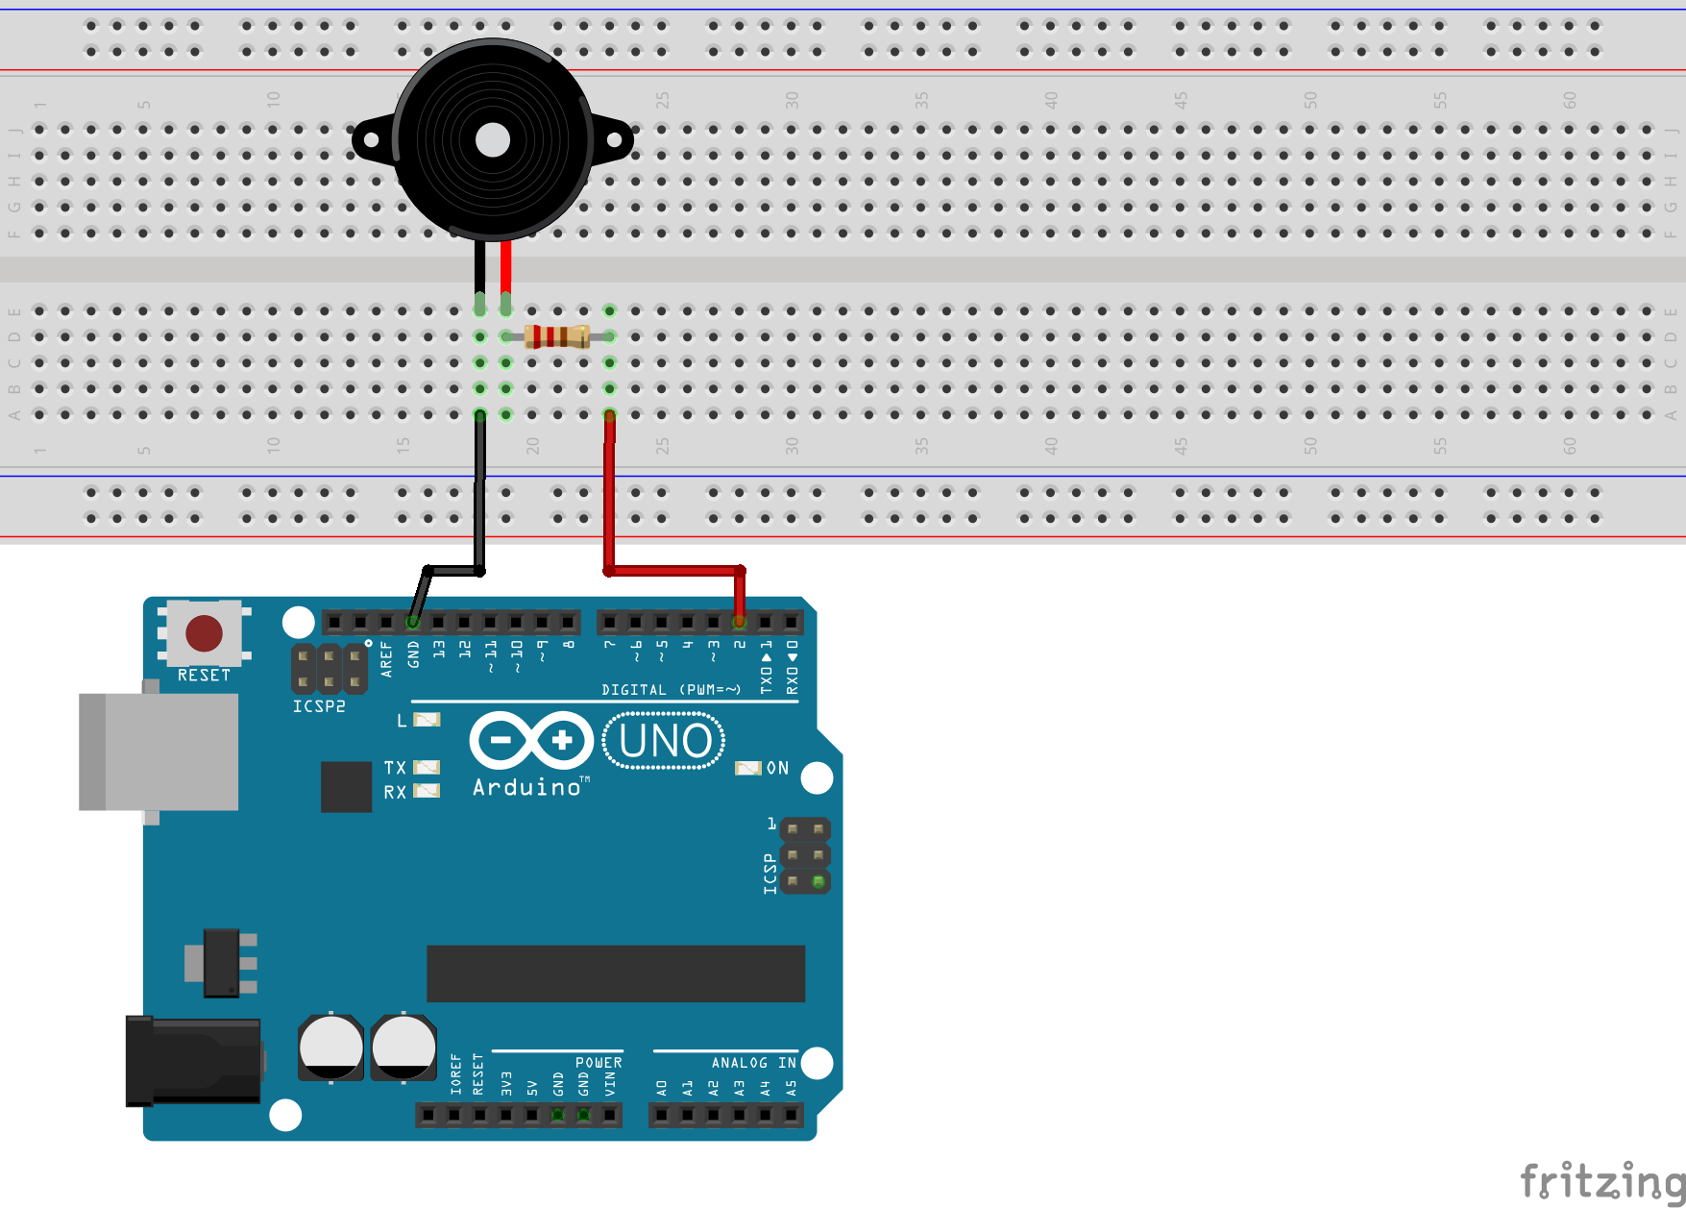
Buzzer

Slide 16
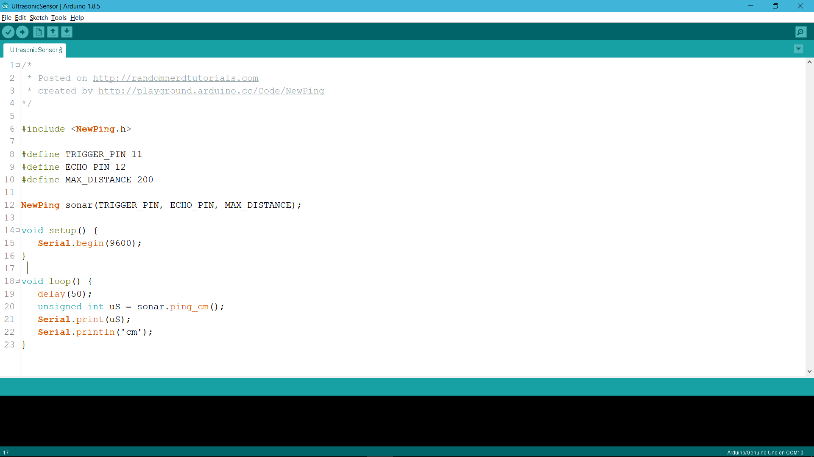
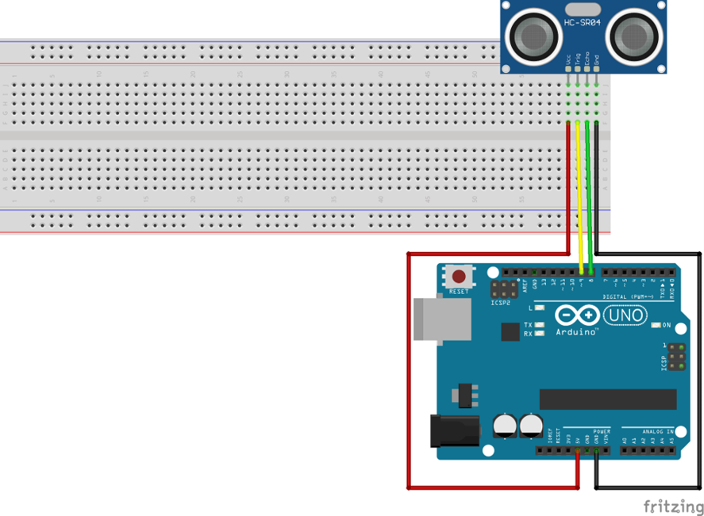
Sensors (click to download library)

Slide 17
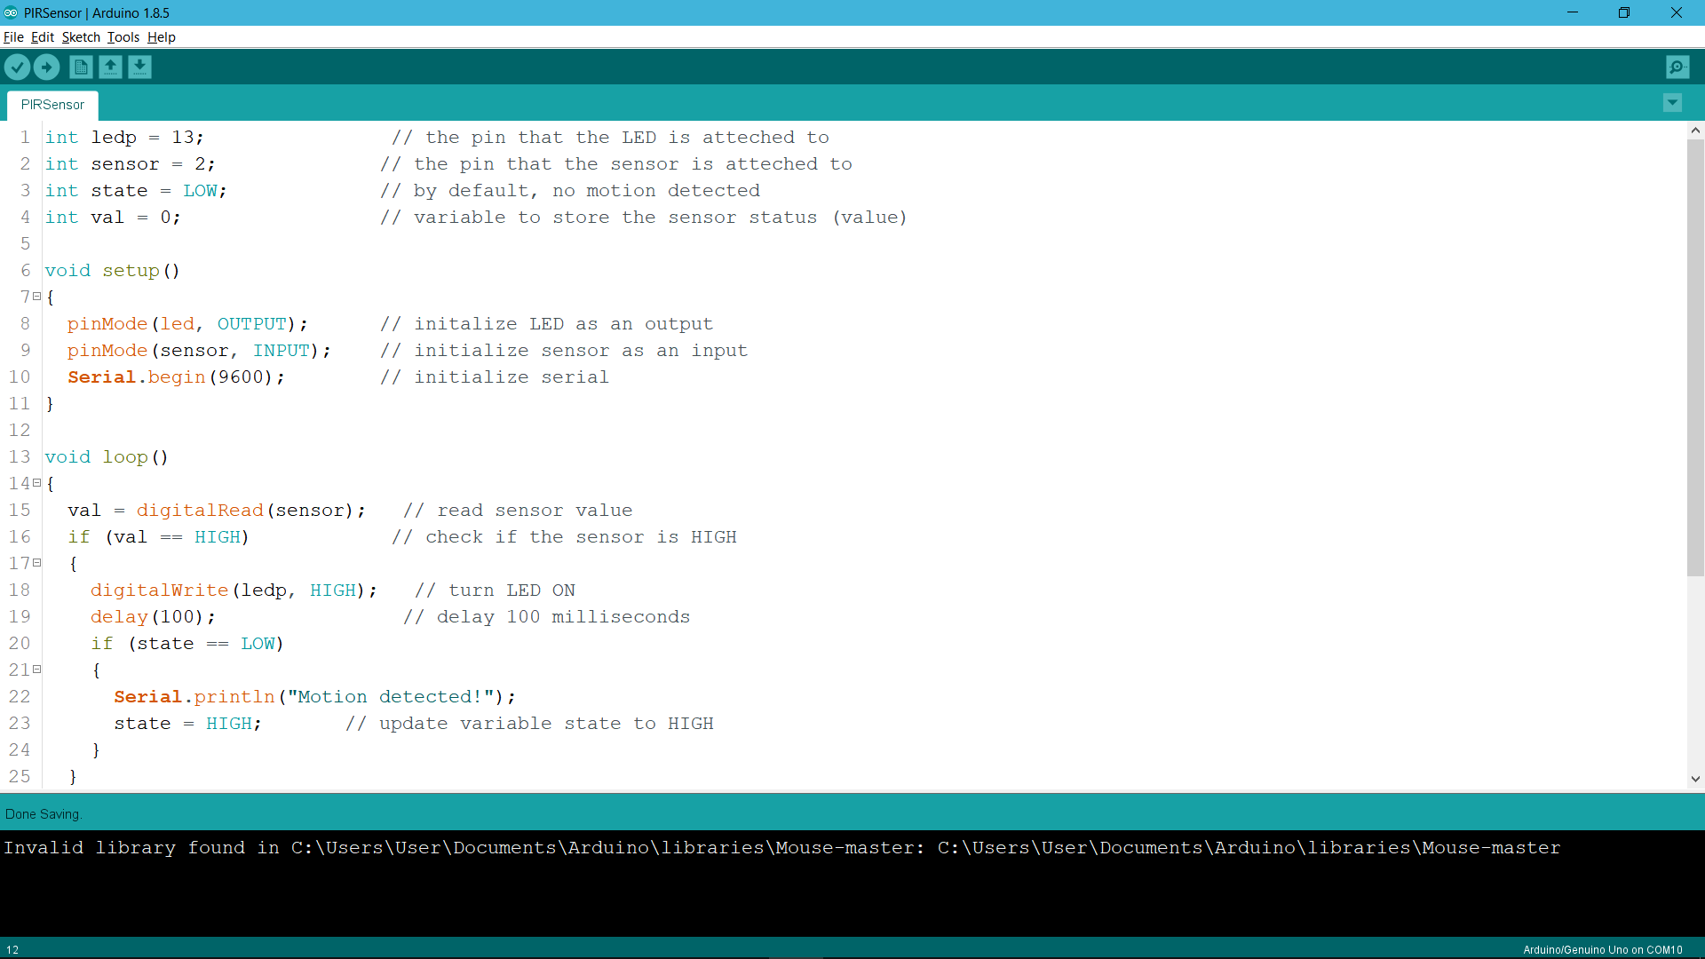
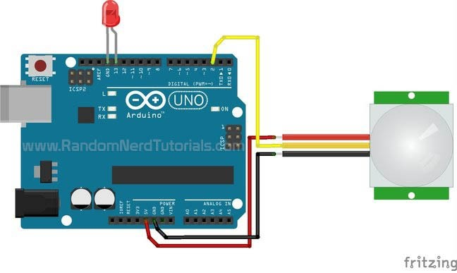

Slide 18
Special sensors? How do I use them?
Click on these links below to find out more!
Chumbaka
Cytron Technologies
Instructables
YouTube

